Slide 1
T-SA:
Twitter keywords Search API based Analysis
(The 19th President Election)
Semester | 2019-1st Semester
Course | INC-CAPSTONE DESIGN 1
Professor | Jung HyunSook
Team Name | VI
Leader | Lee SeokJune(20165072)
Member | Bae InGyu(20165073)
 | Lee Yunhyuck(20165062)
 | Seo JaeIck(20144773)
Presenter | Lee Yunhyuck
Announcement date | 2019. 06. 13.

Slide 2
T-SA: Contents
Twitter keywords Search API based Analysis (The 19th President Election)
1. T-SA: Team Introduction
2. T-SA: Purpose of Development
3. T-SA: Related Works & Control Group
4. T-SA: Development Environment
5. T-SA: Program Flowchart
6. T-SA: Application of API
7. T-SA: Implementation
8. T-SA: Result
9. T-SA: Conclusion
10. T-SA: Review
11. T-SA: Reference

Slide 3




T-SA: Team Introduction
Twitter keywords Search API based Analysis (The 19th President Election)
Lee SeokJune
Computer Engineering, Chosun University (20165072)
op2se1@gmail.com
Establishing and managing the MariaDB
Implementing Twitter APIs
Visualization Implementation
Creating and modifying documents
Lee Yunhyuck
Computer Engineering, Chosun University (20165062)
leeyh5134@naver.com
Hadoop3, Establishment of Sqoop Environment
Hadoop (Map/Reduce)Implementation
Bae InGyu
Computer Engineering, Chosun University (20165073)
happykkk789@naver.com
Python, DB Interlink Implementation
Seo JaeIck
Computer Engineering, Chosun University (20144773)
nero8879@naver.com
Visualization Implementation

Slide 4
T-SA: Purpose of Development
Twitter keywords Search API based Analysis (The 19th President Election)
Collects tweets with keywords related to candidates during the 19th presidential campaign.
* During the campaign period (2017.04.18 to 2017.05.09; from the day after the candidate registration deadline on the 22nd to the day of the election)
Compare and analyze the number of tweets and candidates mentioned.
Notes:
기간 수정
선거 기간-> 유세 기간.
글을 짧게

Slide 5
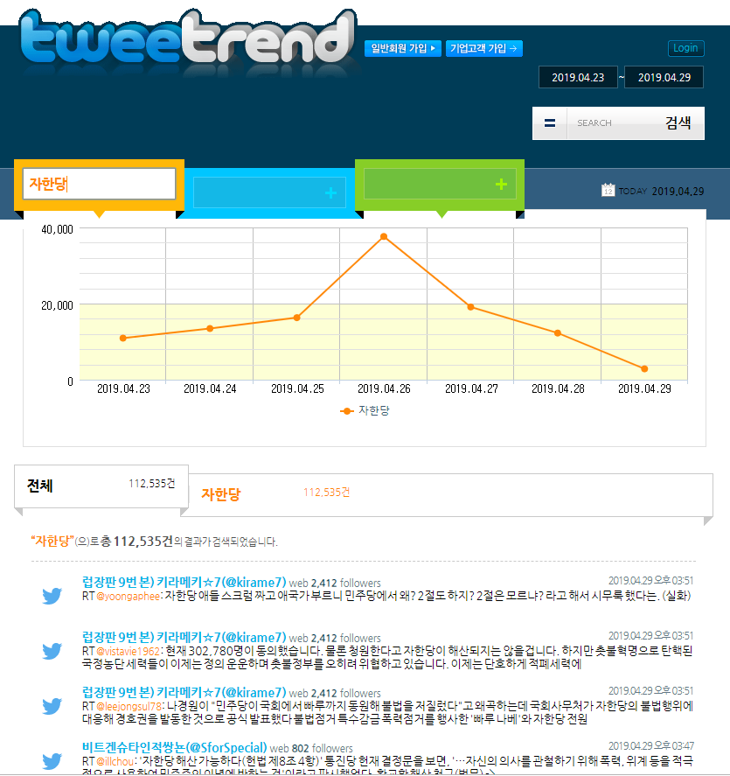
T-SA: Related Works
Twitter keywords Search API based Analysis (The 19th President Election)
Tweetrend : http://tweetrend.com/
1. Set a time period to search
Non-members : Up to 7 days searchable
General member (Free) : Searchable for up to 30 days
General member (Charged) : Searchable for up to 6 months
2. Enter search keywords
Non-members : 1 keywords can be entered
Login : Up to 3 keywords can be entered
3. Tweets Count by Date via Graph
4. Print the list from the total number of tweets
and the most recent tweets
Search keywords to find associated keywords.

Slide 6
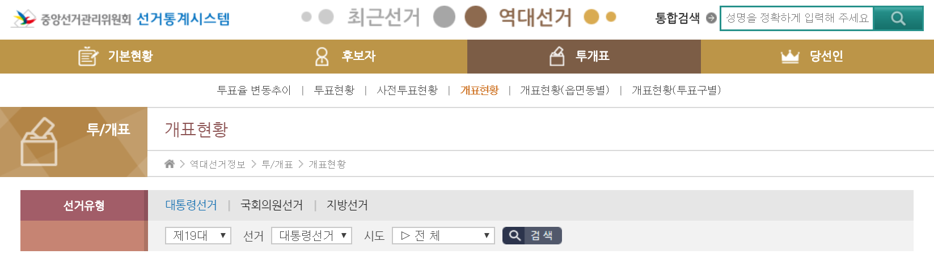
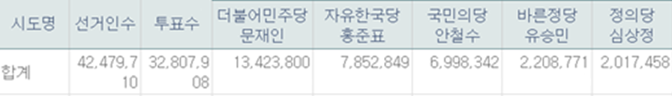
T-SA: Control Group
Twitter keywords Search API based Analysis (The 19th President Election)
National Election Commission Election Statistics System http://info.nec.go.kr/
We use public data, among them, the election statistics system
of the N.E.C. will bring the votes of the top five candidates
Notes:
표 엑셀로 사진 찍어서 수정(수치만 표시. 퍼센트 X)
표를 다음 페이지로 넘겨서

Slide 7
T-SA: Development Environment
Twitter keywords Search API based Analysis (The 19th President Election)
Installation sequence | Name | Version | Reasons for use
1 | Python | 3.6 | Easy to test and visualize acquisition data because it is based on a CLI(Command Line Interface).
https://www.python.org/
2 | MariaDB | 10.1.38 | Select RDBMS because the collection data is structured. RDMBS owned by Oracle selects MariaDB because the license is uncertain.
https://mariadb.com/kb/ko/mariadb
3 | OpenJDK | 1.8.0_191 | JVM for running Java applications, JDK for compiles. Select JDK 8 for Hadoop and Sqoop driving.
https://openjdk.java.net/
4 | Eclipse | 2019-03(4.11) | Free development tools as IDE(Integrated Development Environment). Implement Hadoop (JAVA-based open source frame work).
https://www.eclipse.org/
5 | Hadoop | 3.2.0 | JAVA software frame work that supports distributed applications. Built-in collection of MapReduce over 2.0, performance is 30% better.
https://hadoop.apache.org/
6 | Sqoop | 1.4.7 | Tools designed to transfer large amounts of data between Hadoop and RDBMS.
https://sqoop.apache.org/
Notes:
사용이유 한 줄로 줄이기
(단어 설명 추가, 예상 질문과 설명)
CLI- 사용자의 명령어 입력을 기다리며, 사용자의 명령어 입력이 완료되면 해당 명령어를 실행하고, 결과를 문자열 형태로 출력.
정형 데이터 -통계적 분석에 사용될 수 있을만한 형태로 정리되고 가공된 데이터를 의미.
RDBMS
JVM
JDK
IDE

Slide 8
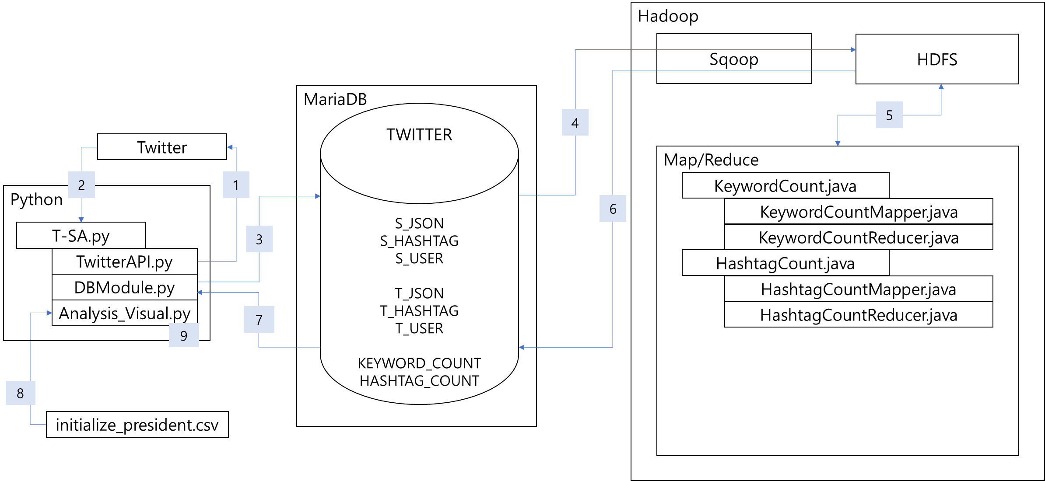
T-SA: Program Flowchart
Twitter keywords Search API based Analysis (The 19th President Election)
[1, 2] (Data collection) Using Twitter API, collect tweet (tweets, hashtags, etc.) and user information(ID, nickname, location information, follow count, number of followers, language, etc.).
[3] (Save data) Store the crawling data in MariaDB.
[4] (Save data) Store data from MariaDB to HDFS using Sqoop.
[5] (Data Analysis and Processing) Normalize the data using Hadoop Map/reduce.
[6] (Save data) Store Normalized data from HDFS to MariaDB.
[7] (Save data) Import data stored in MariaDB into Python.
[8] (Data collection) Collect data to compare (National Election Commission data).
[9] (Analysis and Expression) Visualize imported data (National Election Commission data, Normalization data)
Save data
Data Analysis and Processing
Data collection
Save data
Save data
Save data
Analysis and Expression
Data collection
Notes:
플로우차트
8번 비주얼로 바로 보내기
9번 시각화로 붙이기

Slide 9


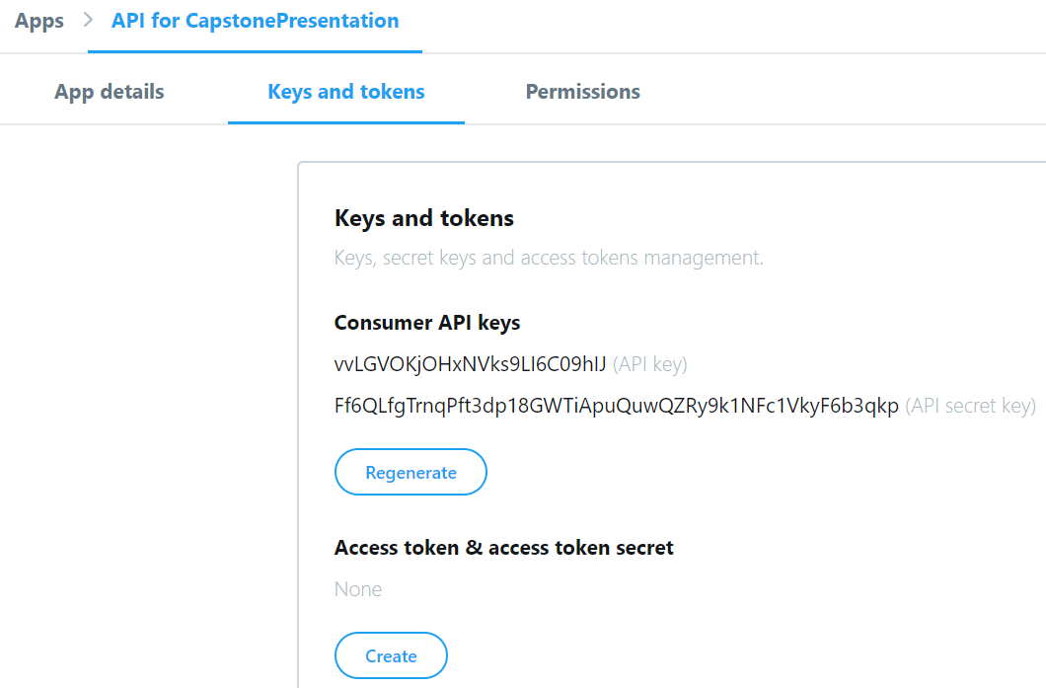
T-SA: Application of API
Twitter keywords Search API based Analysis (The 19th President Election)
Twitter API ISSUED
Must be written
App name (~32 words)
Application description (10~200 words)
Website URL (Ability to display the origin of tweets you create)
Tell us how app will be used (100 words)
If you fill out some questions, you can get a key.

Slide 10
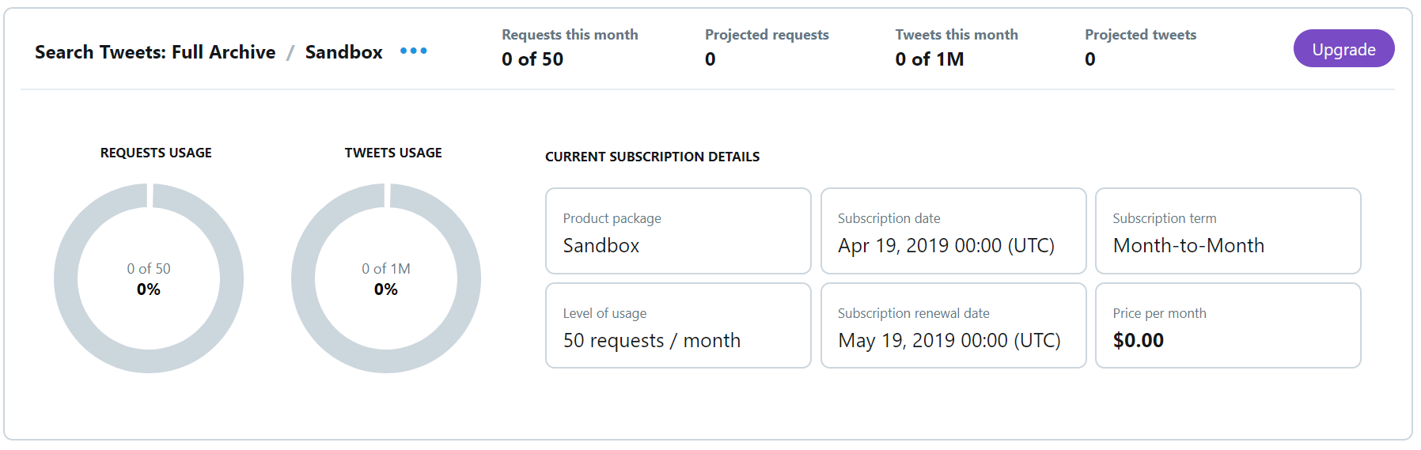
T-SA: Application of API
Twitter keywords Search API based Analysis (The 19th President Election)
Twitter API TYPE
After logging in to the Twitter developer's site, you can upgrade it through Subscription.

Slide 11
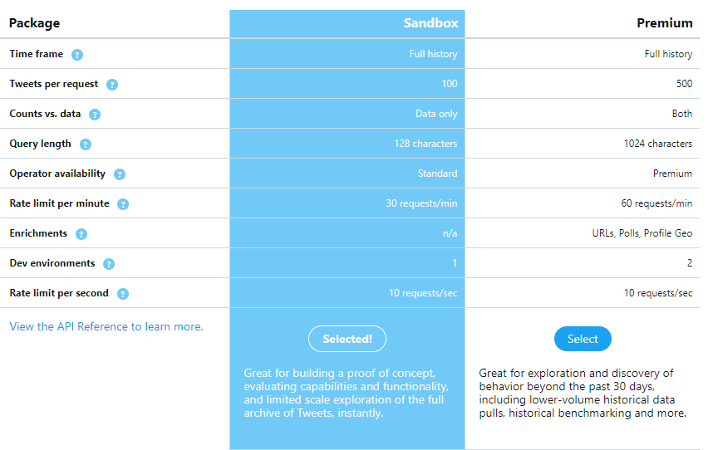
T-SA: Application of API
Twitter keywords Search API based Analysis (The 19th President Election)
Twitter API TYPE
What's the difference between Sandbox and Premium?
Increase the number of tweets you can import from 100 to 500 on a single request
The number of characters in a tweet that can be viewed increases from 128 to 1024 characters
Increase the number of requests per minute from 30 to 60
So we used the premium version!!

Slide 12
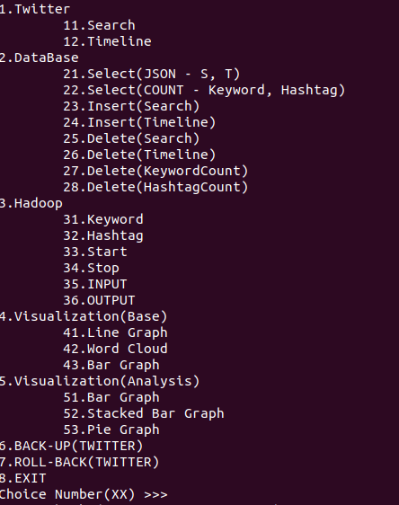
T-SA: Implementation
Twitter keywords Search API based Analysis (The 19th President Election)
Execution Menu of T-SA
Title list stored of python list
for x in range(0, len(Title)):
for y in range(0, len(Title[x])):
print('%s.%s' % (x + 1, Title[x][y])) if y == 0 else print('\t%s%s.%s' % (x + 1, y, Title[x][y]))
print('Choice Number(XX) >>>')
Print the contents of the Title list using a repeated statement to reduce the use of the Print function.
Each number has the function of importing data from a Twitter, storing or normalizing the data.

Slide 13
T-SA: Implementation
Twitter keywords Search API based Analysis (The 19th President Election)
Execution of T-SA number 11(Search), 12(Timeline)
Run through SearchTweet function on TwitterAPI.py
Request Tweets from Full-Archive
Tweets Per Response (10~500, Sandbox(~100), Premium(~500))
requests.get(searchUrl, headers = searchHeaders, params = searchParams)
searchUrl: Response, an array of Tweet JSON
headers: The accessible key that was previously issued
params: A search query that brings out tweets mentioned by five candidates during the election.
11. Search
searchParams = { 'query': query,
'fromDate': fromDate,
'toDate': toDate,
'maxResults' : maxResults }
12. Timeline
searchParams = { 'screen_name': screenName,
'count': count,
'include_rts': include_rts}

Slide 14
T-SA: Implementation
Twitter keywords Search API based Analysis (The 19th President Election)
<Tweets in JSON format when using Search API>
https://developer.twitter.com/en/docs/tweets/search/api-reference/get-search-tweets
Use JSON to make and save user information in a list of tweets.
{ "statuses": [ { "created_at": "Mon May 06 20:01:29 +0000 2019", "id": 1125490788736032770, "id_str": "1125490788736032770", "text": "Today's new update means that you can finally add Pizza Cat to your Retweet with comments! Learn more about this ne… https://t.co/Rbc9TF2s5X", "truncated": true, "entities": { "hashtags": [], "symbols": [], "user_mentions": [], "urls": [ { "url": "https://t.co/Rbc9TF2s5X", "expanded_url": "https://twitter.com/i/web/status/1125490788736032770", "display_url": "twitter.com/i/web/status/1…", "indices": [ 117, 140 ] } ] }, "metadata": { "iso_language_code": "en", "result_type": "recent" }, "source": "<a href="https://mobile.twitter.com" rel="nofollow">Twitter Web App</a>", "in_reply_to_status_id": null, "in_reply_to_status_id_str": null, "in_reply_to_user_id": null, "in_reply_to_user_id_str": null, "in_reply_to_screen_name": null, "user": { "id": 2244994945, "id_str": "2244994945", "name": "Twitter Dev", "screen_name": "TwitterDev", "location": "Internet", "description": "Your official source for Twitter Platform news, updates & events. Need technical help? Visit https://t.co/mGHnxZU8c1 ⌨️ #TapIntoTwitter", "url": "https://t.co/FGl7VOULyL", "entities": { "url": { "urls": [ { "url": "https://t.co/FGl7VOULyL", "expanded_url": "https://developer.twitter.com/", "display_url": "developer.twitter.com", "indices": [ 0, 23 ] } ] },
"description": { "urls": [ { "url": "https://t.co/mGHnxZU8c1", "expanded_url": "https://twittercommunity.com/", "display_url": "twittercommunity.com", "indices": [ 93, 116 ] } ] } }, "protected": false, "followers_count": 501947, "friends_count": 1473, "listed_count": 1507, "created_at": "Sat Dec 14 04:35:55 +0000 2013", "favourites_count": 2186, "utc_offset": null, "time_zone": null, "geo_enabled": true, "verified": true, "statuses_count": 3389, "lang": "en", "contributors_enabled": false, "is_translator": false, "is_translation_enabled": null, "profile_background_color": "null", "profile_background_image_url": "null", "profile_background_image_url_https": "null", "profile_background_tile": null, "profile_image_url": "null", "profile_image_url_https": "https://pbs.twimg.com/profile_images/880136122604507136/xHrnqf1T_normal.jpg", "profile_banner_url": "https://pbs.twimg.com/profile_banners/2244994945/1498675817", "profile_link_color": "null", "profile_sidebar_border_color": "null", "profile_sidebar_fill_color": "null", "profile_text_color": "null", "profile_use_background_image": null, "has_extended_profile": null, "default_profile": false, "default_profile_image": false, "following": false, "follow_request_sent": false, "notifications": false, "translator_type": "null" }, "geo": null, "coordinates": null, "place": null, "contributors": null, "is_quote_status": true, "quoted_status_id": 1125479034513645569, "quoted_status_id_str": "1125479034513645569", "quoted_status": { "created_at": "Mon May 06 19:14:46 +0000 2019",
"id": 1125479034513645569, "id_str": "1125479034513645569", "text": "It's easy to express yourself by Retweeting with a comment. What if you could take it a step further and include me… https://t.co/YTqpNZZ8M9", "truncated": true, "entities": { "hashtags": [], "symbols": [], "user_mentions": [], "urls": [ { "url": "https://t.co/YTqpNZZ8M9", "expanded_url": "https://twitter.com/i/web/status/1125479034513645569", "display_url": "twitter.com/i/web/status/1…", "indices": [ 117, 140 ] } ] }, "metadata": { "iso_language_code": "en", "result_type": "recent" }, "source": "<a href="http://twitter.com" rel="nofollow">Twitter Web Client</a>", "in_reply_to_status_id": null, "in_reply_to_status_id_str": null, "in_reply_to_user_id": null, "in_reply_to_user_id_str": null, "in_reply_to_screen_name": null, "user": { "id": 17874544, "id_str": "17874544", "name": "Twitter Support", "screen_name": "TwitterSupport", "location": "Twitter HQ", "description": "Your official source for Twitter Support. We're available 24/7 via Direct Message to answer account questions. Follow us for tips, tricks, and announcements.", "url": "https://t.co/heEvRrl4yN", "entities": { "url": { "urls": [ { "url": "https://t.co/heEvRrl4yN", "expanded_url": "https://help.twitter.com", "display_url": "help.twitter.com", "indices": [ 0, 23 ] } ] }, "description": { "urls": [] } },
"protected": false, "followers_count": 5861908, "friends_count": 17, "listed_count": 15129, "created_at": "Thu Dec 04 18:51:57 +0000 2008", "favourites_count": 313, "utc_offset": null, "time_zone": null, "geo_enabled": true, "verified": true, "statuses_count": 27955, "lang": "en", "contributors_enabled": false, "is_translator": false, "is_translation_enabled": null, "profile_background_color": "null", "profile_background_image_url": "null", "profile_background_image_url_https": "null", "profile_background_tile": null, "profile_image_url": "null", "profile_image_url_https": "https://pbs.twimg.com/profile_images/941807338171777025/PRP6vwDq_normal.jpg", "profile_banner_url": "https://pbs.twimg.com/profile_banners/17874544/1499274456", "profile_link_color": "null", "profile_sidebar_border_color": "null", "profile_sidebar_fill_color": "null", "profile_text_color": "null", "profile_use_background_image": null, "has_extended_profile": null, "default_profile": false, "default_profile_image": false, "following": false, "follow_request_sent": false, "notifications": false, "translator_type": "null" }, "geo": null, "coordinates": null, "place": null, "contributors": null, "is_quote_status": false, "retweet_count": 1466, "favorite_count": 3990, "favorited": false, "retweeted": false, "possibly_sensitive": false, "lang": "en" }, "retweet_count": 20, "favorite_count": 44, "favorited": false, "retweeted": false, "possibly_sensitive": false, "lang": "en" }, { "created_at": "Sat May 04 15:00:33 +0000 2019", "id": 1124690280777699328, "id_str": "1124690280777699328", "text": "If you're at #Pycon2019 and you use Twitter data or the Twitter API with your code, we are running an Open Space in… https://t.co/mVLIzEr9Gx", "truncated": true, "entities": { "hashtags": [ { "text": "Pycon2019", "indices": [ 13, 23 ] } ],
"symbols": [], "user_mentions": [], "urls": [ { "url": "https://t.co/mVLIzEr9Gx", "expanded_url": "https://twitter.com/i/web/status/1124690280777699328", "display_url": "twitter.com/i/web/status/1…", "indices": [ 117, 140 ] } ] }, "metadata": { "iso_language_code": "en", "result_type": "recent" }, "source": "<a href="http://twitter.com" rel="nofollow">Twitter for iPhone</a>", "in_reply_to_status_id": null, "in_reply_to_status_id_str": null, "in_reply_to_user_id": null, "in_reply_to_user_id_str": null, "in_reply_to_screen_name": null, "user": { "id": 2244994945, "id_str": "2244994945", "name": "Twitter Dev", "screen_name": "TwitterDev", "location": "Internet", "description": "Your official source for Twitter Platform news, updates & events. Need technical help? Visit https://t.co/mGHnxZU8c1 ⌨️ #TapIntoTwitter", "url": "https://t.co/FGl7VOULyL", "entities": { "url": { "urls": [ { "url": "https://t.co/FGl7VOULyL", "expanded_url": "https://developer.twitter.com/", "display_url": "developer.twitter.com", "indices": [ 0, 23 ] } ] }, "description": { "urls": [ { "url": "https://t.co/mGHnxZU8c1", "expanded_url": "https://twittercommunity.com/", "display_url": "twittercommunity.com", "indices": [ 93, 116 ] } ] } },
"protected": false, "followers_count": 501947, "friends_count": 1473, "listed_count": 1507, "created_at": "Sat Dec 14 04:35:55 +0000 2013", "favourites_count": 2186, "utc_offset": null, "time_zone": null, "geo_enabled": true, "verified": true, "statuses_count": 3389, "lang": "en", "contributors_enabled": false, "is_translator": false, "is_translation_enabled": null, "profile_background_color": "null", "profile_background_image_url": "null", "profile_background_image_url_https": "null", "profile_background_tile": null, "profile_image_url": "null", "profile_image_url_https": "https://pbs.twimg.com/profile_images/880136122604507136/xHrnqf1T_normal.jpg", "profile_banner_url": "https://pbs.twimg.com/profile_banners/2244994945/1498675817", "profile_link_color": "null", "profile_sidebar_border_color": "null", "profile_sidebar_fill_color": "null", "profile_text_color": "null", "profile_use_background_image": null, "has_extended_profile": null, "default_profile": false, "default_profile_image": false, "following": false, "follow_request_sent": false, "notifications": false, "translator_type": "null" }, "geo": null, "coordinates": null, "place": null, "contributors": null, "is_quote_status": false, "retweet_count": 12, "favorite_count": 27, "favorited": false, "retweeted": false, "possibly_sensitive": false, "lang": "en" } ], "search_metadata": { "completed_in": 0.047, "max_id": 1125490788736032770, "max_id_str": "1125490788736032770", "next_results": "?max_id=1124690280777699327&q=from%3Atwitterdev&count=2&include_entities=1&result_type=mixed", "query": "from%3Atwitterdev", "refresh_url": "?since_id=1125490788736032770&q=from%3Atwitterdev&result_type=mixed&include_entities=1", "count": 2, "since_id": 0, "since_id_str": "0" } }

Slide 15
T-SA: Implementation
Twitter keywords Search API based Analysis (The 19th President Election)
Execution of T-SA number 21,22 Select
Run through dbSelect function on DBModule.py
It can be connected with host address, ID and password information for the Database.
All of them(Insert, Select, Delete) use the dbConnection function to access MariaDB
The SQL SELECT Statement
‘SELECT %s FROM %s %s;' % (cols, tabs, cond)
Cols: The column list of the tabs to be inquired.
Tabs: The table list to be inquired.
Table list = ('S_JSON', 'S_HASHTAG', 'S_USER', 'T_JSON', 'T_HASHTAG', 'T_USER', 'KEYWORD_COUNT', 'HASHTAG_COUNT')
Cond: To specify the conditions to be inquired.

Slide 16
T-SA: Implementation
Twitter keywords Search API based Analysis (The 19th President Election)
Execution of T-SA number 23,24 Insert
Run through dbInsert function on DBModule.py
Check for duplication of data in the database before inserting.
The SQL INSERT Statement
'INSERT INTO ' + tableNm + VALUES
tableNm: The name is the table to be inserted
VALUES: Insert tweeter information

Slide 17
T-SA: Implementation
Twitter keywords Search API based Analysis (The 19th President Election)
Execution of T-SA number 25~28 Delete
Run through dbDelete function on DBModule.py
The SQL DELETE Statement
'DELETE FROM %s;' % tableNm
tableNm: The name is the table to be deleted.
Lastly, All of them(Insert, Select, Delete) use the dbClose function to close MariaDB

Slide 18
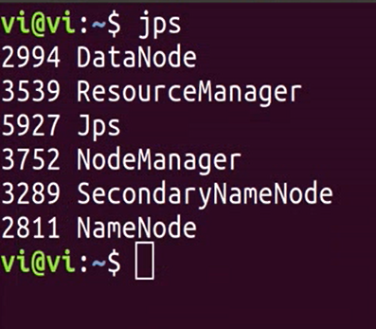
T-SA: Implementation
Twitter keywords Search API based Analysis (The 19th President Election)
Execution of T-SA number 31, keyword
Run through The Commands that Sqoop Import, Map/Reduce, Sqoop export
31.keyword, 32Hashtag
33.Start
34.Stop
Hadoop start
Sqoop import
Map/Reduce
Sqoop export
Hadoop stop
Run Hadoop
First Run Hadoop for map/reduce
And then, execute number 31 or 32

Slide 19
T-SA: Implementation
Twitter keywords Search API based Analysis (The 19th President Election)
Execution of T-SA number 31, keyword
SQOOP IMPORT
sqoop import --connect jdbc:mysql://localhost/TWITTER --username T-SA --password 1234 --table S_JSON --columns TEXT --target-dir hdfs://localhost:9000/user/vi/keyword_INPUT -m 1
Connect: The jdbc address to be associated with MariaDB.
userName, password: The user account of the database.
Table: The name of the table to be imported from the database.
Columns: The columns of data to be imported.
target-dir: The path to be stored in HDFS.

Slide 20
T-SA: Implementation
Twitter keywords Search API based Analysis (The 19th President Election)
Sqoop(Import) Result
Map/Reduce Result
Sqoop(Export) Result
Map-Reduce Framework
Map input records=26291
Map output records=26291
Input split bytes=87
Spilled Records=0
Failed Shuffles=0
Merged Map outputs=0
GC time elapsed (ms)=51
CPU time spent (ms)=1740
Physical memory (bytes) snapshot=225447936
Virtual memory (bytes) snapshot=2666721280
Total committed heap usage (bytes)=188219392
Peak Map Physical memory (bytes)=225447936
Peak Map Virtual memory (bytes)=2666721280
Map-Reduce Framework Map input records=68408 Map output records=317389 Map output bytes=3777867 Map output materialized bytes=154548 Input split bytes=121 Combine input records=317389 Combine output records=10924 Reduce input groups=10924 Reduce shuffle bytes=154548 Reduce input records=10924 Reduce output records=10924 Spilled Records=21848 Shuffled Maps =1 Failed Shuffles=0 Merged Map outputs=1 GC time elapsed (ms)=1566013 CPU time spent (ms)=79441010 Physical memory (bytes) snapshot=1050202112 Virtual memory (bytes) snapshot=5327437824 Total committed heap usage (bytes)=860880896 Peak Map Physical memory (bytes)=877592576 Peak Map Virtual memory (bytes)=2683715584 Peak Reduce Physical memory (bytes)=177844224 Peak Reduce Virtual memory (bytes)=2664820736
Map-Reduce Framework
Map input records=10924
Map output records=10924
Input split bytes=626
Spilled Records=0
Failed Shuffles=0
Merged Map outputs=0
GC time elapsed (ms)=740
CPU time spent (ms)=6080
Physical memory (bytes) snapshot=936022016
Virtual memory (bytes) snapshot=10656645120
Total committed heap usage (bytes)=728236032
Peak Map Physical memory (bytes)=249868288
Peak Map Virtual memory (bytes)=2667040768
As a result, 10,924 nouns were stored in the database after normalization for 22 hours

Slide 21
T-SA: Implementation
Twitter keywords Search API based Analysis (The 19th President Election)
Execution of T-SA number 31, keyword
MAP/REDUCE
yarn jar /home/vi/hadoop/jar/keywordCount.jar keywordCount /user/vi/keyword_INPUT/part-m-00000 keyword_OUTPUT
Enter the jar path and the configured java file, the data path to use,
and the path where the results will be stored.
Only nouns are used to analyze the frequency of keywords.
Among the open sources in Java language,
Komoran was used with high speed and accuracy.

Slide 22
T-SA: Implementation
Twitter keywords Search API based Analysis (The 19th President Election)
Execution of T-SA number 31(Keyword), 32(Hashtag)
SQOOP EXPORT
sqoop export --connect jdbc:mysql://localhost/ TWITTER --username T-SA --password 1234 --table keyword_COUNT --export-dir hdfs://localhost:9000/user/vi/keywords_OUTPUT/part-r-00000 --columns keyword,COUNT --input-fields-terminated-by "\t"
input-fields-terminated-by means delimiter
These commands are executed automatically using the system function of os modules.

Slide 23
T-SA: Result (Used data)
Twitter keywords Search API based Analysis (The 19th President Election)
query = '"문재인" OR "홍준표" OR "안철수" OR "유승민" OR "심상정“’
date = ('201704180000', '201705100000')
maxResults = 100
1day = 4 Search
00:00:00 ~ 06:00:00
06:00:00 ~ 12:00:00
12:00:00 ~ 18:00:00
18:00:00 ~ 00:00:00
Total Data = 1 day(1200) * 22(campaign period)
=26,400

Slide 24

T-SA: Result (Visualization)
Twitter keywords Search API based Analysis (The 19th President Election)
Execution of T-SA number 41~43, Tweets based Visualization
Results of WordCloud in the 19th presidential election
query = '"문재인" OR "홍준표" OR "안철수" OR "유승민" OR "심상정"'
Period: (2017-04-18 ~ 2017-05-09)
What is the worldcloud? To check the frequency of words

Slide 25
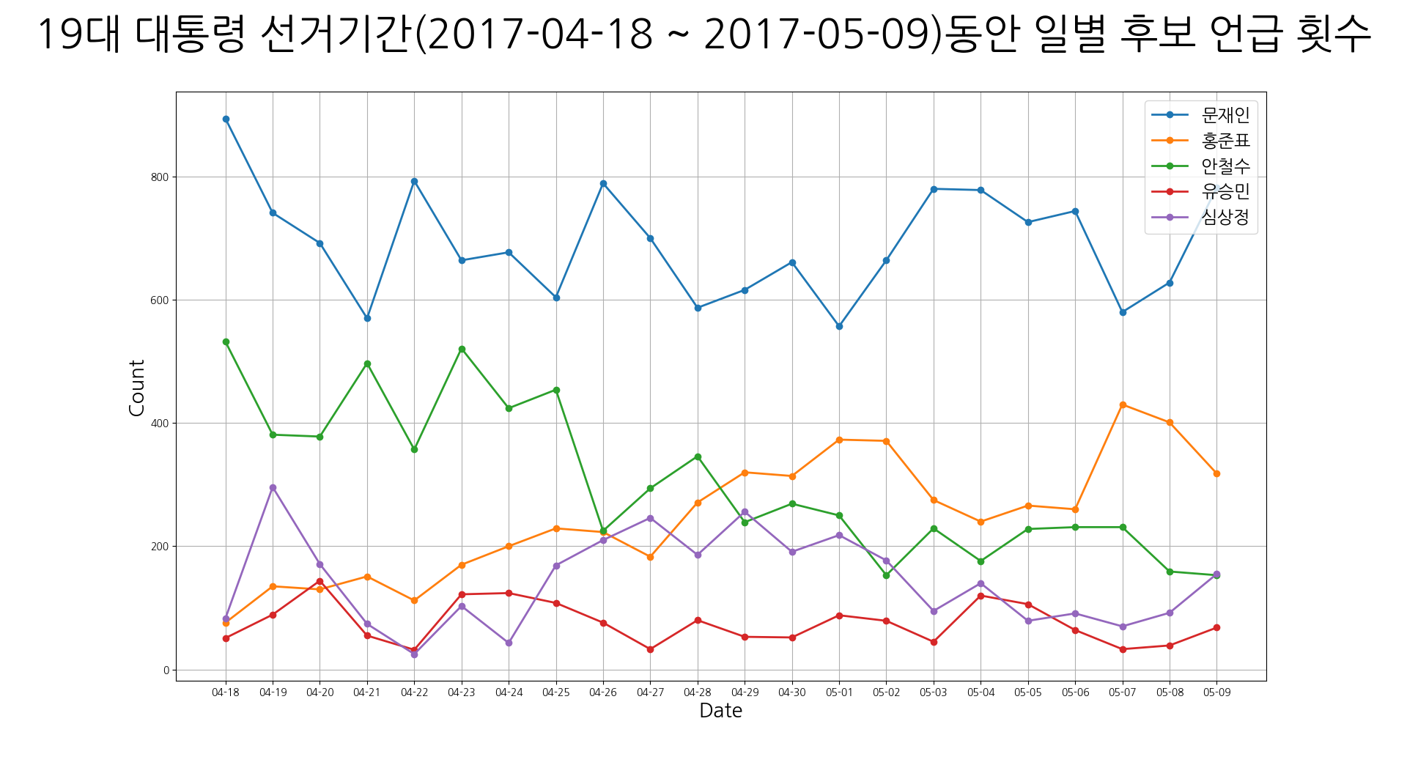
T-SA: Result (Visualization)
Twitter keywords Search API based Analysis (The 19th President Election)
The number of tweets mentioned by each candidate during the 19th presidential election
Period: (2017-04-18 ~ 2017-05-09)
Candidate Moon Jae-in of the blue line graph has a high frequency of mentioning daily,
while Hong Joon-pyo shows a remarkable increase in the number of referrals
by Ahn Cheol-soo while the reference is decreased with time.
Notes:
워드, 라인, 파이
각 그래프 결과 글로 설명
워드 클라우드 설명

Slide 26
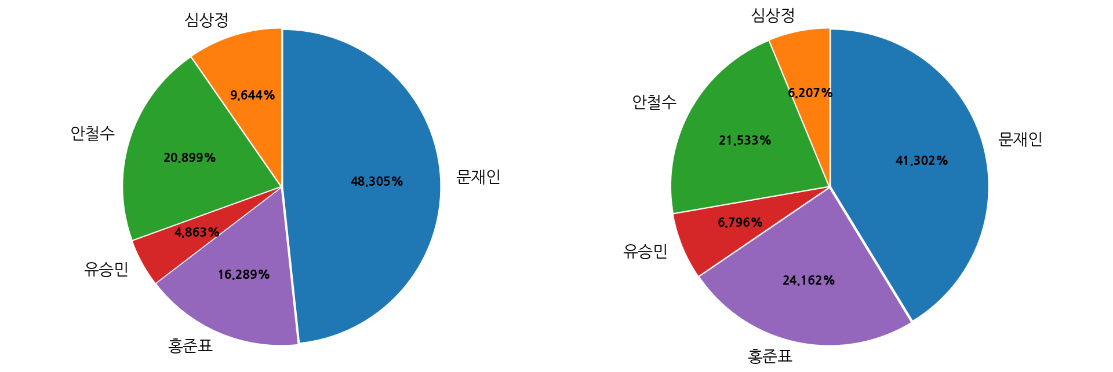
T-SA: Result (Visualization)
Twitter keywords Search API based Analysis (The 19th President Election)
Execution of T-SA number 51~53, Tweets and The percentage of votes based on visualization analysis
Top 5 Candidate Tweets Referenced and Actual Vote
Tweets Referenced
Actual Vote
You can see the correlation between the top five candidates and the actual rate
of voting during the election period.
As a result, the two indicators are similar.

Slide 27
T-SA: Conclusion
Twitter keywords Search API based Analysis (The 19th President Election)
Expectation Effectiveness
The 19th presidential election can confirm a similar pattern of tweets and actual voter turnout.
As a result, we hope that the next presidential election will be able to predict the president-elect based on this.
Future plans.
1. We will be apply to other elections to raise the accuracy of the project.
2. We will collect and apply the pre-election data to see how it affects the outcome.

Slide 28
T-SA: Review
Twitter keywords Search API based Analysis (The 19th President Election)
Lee SeokJune
Bae InGyu
Lee Yunhyuck
Seo JaeIck

Slide 29
T-SA: Reference
Twitter keywords Search API based Analysis (The 19th President Election)
Tweetrend, http://tweetrend.com/
Foller.me beta, https://foller.me/
중앙선거관리위원회 선거통계시스템, http://info.nec.go.kr/
Twitter Developer, https://developer.twitter.com/
Search Tweets, https://developer.twitter.com/en/docs/tweets/search/guides/standard-operators
정재화, 시작하세요! 하둡 프로그래밍 빅데이터 분석을 위한 하둡 기초부터 YARN까지[개정2판], 2016.05.13, 위키북스

Slide 30
Thank you

Slide 31
Q & A

Slide 32
T-SA: Team Introduction
Twitter keywords Search API based Analysis (The 19th President Election)
이석준 (Lee SeokJune)
MariaDB 환경 구축 및 관리
Twitter API 구현
문서 작성 및 수정
이윤혁 (Lee Yunhyuck)
Hadoop3, Sqoop 환경 구축
Hadoop(Map/Reduce)구현
배인규 (Bae InGyu)
Python, DB 연동 구현
Visualization 구현
서재익 (Seo JaeIck)
Twitter API 구현
Visualization 구현
Notes:
맡은 역할만

Slide 33
용어 정리

Slide 34
T-SA: 용어 정리
Twitter keywords Search API based Tweet Analysis
CLI( Command-Line Interface)
사용자의 명령어 입력을 기다리며, 명령어 입력이 완료되면 해당 명령어를 실행하고, 결과를 출력.
정형 데이터
통계적 분석에 사용될 수 있을만한 형태로 정리되고 가공된 데이터를 의미.
RDBMS
관계형 데이터베이스를 생성하고 수정하고 관리할 수 있는 소프트웨어
JVM
Java로 개발한 프로그램을 컴파일하여 만들어지는 바이트코드를 실행시키기 위한 가상 머신
JDK
Java 환경에서 돌아가는 프로그램을 개발하는 데 필요한 툴들을 모아놓은 소프트웨어 패키지
IDE
소프트웨어 개발에 관련된 모든 작업(패키지 인클루딩, 소스 코드 편집, 컴파일, 디버그, 원격 서버 액세스, 바이너리 배포 등)을 하나의 프로그램 안에서 모두 처리하는 환경을 제공하는 툴

Slide 35
T-SA: 용어 정리
Twitter keywords Search API based Tweet Analysis
콜렉터(Collector)
여러 대의 에이전트로부터 로그 정보를 수신해서 하둡 분산 파일시스템에 저장하는 역할을 담당, 여러 대의 에이전트 서버로부터 데이터를 전송받지만 하나의 파일에 저장
맵리듀스(MapReduce)
대용량 데이터 처리를 분산 병렬 컴퓨팅에서 처리하기 위한 목적으로 제작한 프레임워크.
배열 안의 요소들을 1대1로 짝지어 주는 맵과 Key값을 이용해서 Value값을 합쳐주는 리듀스로 이루어짐.

Slide 36
예상질문

Slide 38










T-SA: Development Environment
Twitter keywords Search API based Tweet Analysis
3.6
10.1.38
1.8.0_191
2019-03(4.11)
3.2.0
1.4.7
https://www.python.org/
https://www.python.org/
https://www.python.org/
https://www.python.org/
https://www.python.org/
https://www.python.org/

Slide 39
T-SA: Development Environment
Twitter keywords Search API based Tweet Analysis
- 파이썬(Python)은 1991년 프로그래머인 귀도 반 로섬(Guido van Rossum)이 발표한 고급 프로그래밍 언어로, 플랫폼 독립적이며 인터프리터식, 객체 지향적, 동적 타이핑 대화형 언어이다.
- 파이썬은 비영리의 파이썬 소프트웨어 재단이 관리하는 개방형, 공동체 기반 개발 모델을 가지고 있다.
3.6
Python site
https://www.python.org/
Python 설치
~$ sudo apt-get install python3
Version Check
~$ python3 --version
Python 3.6

Slide 40
T-SA: Development Environment
Twitter keywords Search API based Tweet Analysis
MariaDB는 MySQL의 발전된 형태의 대체제로써, https://downloads.mariadb.org/에서 다운로드 받을 수 있으며, GPL v2 라이선스로 유지되고 있고, MariaDB 커뮤니티와 MariaDB 재단이 주축이 되어 개발되고 있다.
MariaDB는 현재까지 최신의 MaySQL과 같은 브랜치로부터 릴리즈되며, 대개의 경우 MySQL과 마찬가지로 동작한다. MySQL의 모든 명령어, 인터페이스, 라이브러리와 API가 MariaDB에도 존재한다. 또한 MariaDB로 데이터베이스를 변환할 필요도 없다.
10.1.38
MariaDB site
https://www.python.org/

Slide 41
T-SA: Development Environment
Twitter keywords Search API based Tweet Analysis
MariaDB 설치
~$ sudo apt-get install mariadb-server
MariaDB 권한 테이블 설정
~$ sudo mysql_secure_installation
Version Check
~$ mariadb –version
mariadb Ver 15.1 Distrib 10.1.38-MariaDB, for debian-linux-gnu (x86_64) using readline 5.2
Enter current password for root (enter for none) → MariaDb의 root계정은 쉘 인증이 기본적으로 설정되므로 root계정으로 실행됐다면 비밀번호 없이(Enter) 아니면 비밀번호 입력
Set root password? [Y/n] → 따로 패스워드를 설정하고 싶으면 Y, root그대로 사용 할려면 n
Remove anonymous users? [Y/n] → 익명 사용자를 삭제 할지 여부
Disallow root login remotely? [Y/n] → 원격 접속으로 루트 로그인 허용 여부
Remove test database and access to it? [Y/n] → 테스트 데이터베이스 삭제 여부
Reload privilege tables now? [Y/n] → 지금까지 작성한 권한 테이블을 적용 여부

Slide 42
T-SA: Development Environment
Twitter keywords Search API based Tweet Analysis
- 이클립스(Eclipse)는 다양한 플랫폼에서 쓸 수 있으며, 자바를 비롯한 다양한 언어를 지원하는 프로그래밍 통합 개발 환경을 목적으로 시작하였으나, 현재는 OSGi(Open Service Gateway initiative)를 도입하여, 범용 응용 소프트웨어 플랫폼으로 진화하였다.
- OpenJDK는 Java SE (Standard Edition) 기반의 오픈 소스 JDK다. 2006년 Sun Micro System 은 Java를 오픈 소스화한다고 발표하였다. 그리고 그해 11월 HotSpot VM과 컴파일러를 GNU General Public License(이하 GPL)로 풀었다.
1.8.0_191
2019-03(4.11)
OpenJDK 설치
~$ sudo apt-get install openjdk-8-jdk
Version Check
~$ java –version
openjdk version "1.8.0_191"
OpenJDK Runtime Environment (build 1.8.0_191-8u191-b12-2ubuntu0.18.04.1-b12)
OpenJDK 64-Bit Server VM (build 25.191-b12, mixed mode)

Slide 43
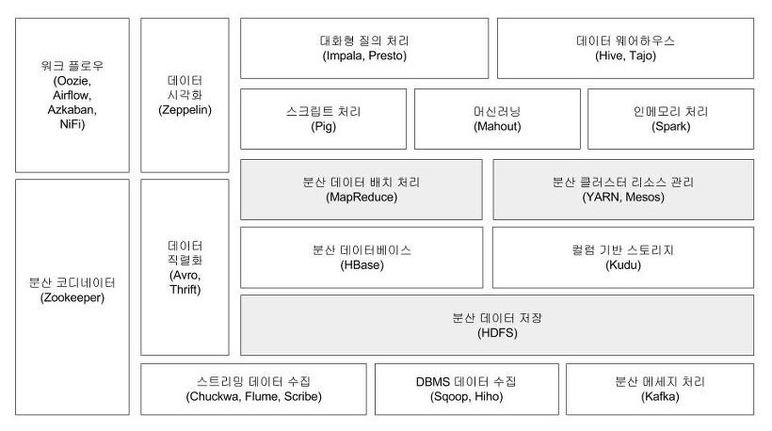
T-SA: Development Environment
Twitter keywords Search API based Tweet Analysis
3.2.0
1.4.7
아파치 하둡(Apache, High-Availability Distributed Object-Oriented Platform)은 대량의 자료를 처리할 수 있는 큰 컴퓨터 클러스터에서 동작하는 분산 응용 프로그램을 지원하는 프리웨어 자바 소프트웨어 프레임워크이다.
스쿱(Sqoop)은 구조화된 관계형 데이터베이스와 아파치 하둡 간의 대용량 데이터들을 효율적으로 변환하여 주는 CLI(Command-Line Interface) 애플리케이션이다.

Slide 44
T-SA: Development Environment
Twitter keywords Search API based Tweet Analysis
Hadoop
SSH(Secure Shell) 설정
~$ sudo apt-get install ssh
~$ ssh-keygen -t rsa -P '' -f ~/.ssh/id_rsa
~$ cat ~/.ssh/id_rsa.pub>>~/.ssh/authorized_keys
~$ chmod 0600 ~/.ssh/authorized_keys
Protobuf 2.5.0 설치
~$ sudo apt-get install g++ pentium-builder
~$ cd /usr/local/
~$ sudo wget https://github.com/google/protobuf/releases/download/v2.5.0/protobuf-2.5.0.tar.gz
~$ sudo tar xvzf protobuf-2.5.0.tar.gz
~$ sudo tar xvzf protobuf-2.5.0.tar.gz
~$ cd protobuf-2.5.0
~$ ./configure
~$ make
~$ make install
Hadoop3.2.0 설치
~$ tar xvzf hadoop-3.2.0.tar.gz
~$ ln -s hadoop3.2.0 hadoop
~$ sudo gedit ~/.bashrc
~$ vi hadoop-env.sh
~$ vi core-site.xml
~$ ~$ ~$
export HADOOP_HOME=/home/yunhyuck/hadoop
export PATH=$PATH:$HADOOP_HOME/bin
export PATH=$PATH:$HADOOP_HOME/sbin
export HADOOP_MAPRED_HOME=${HADOOP_HOME}
export HADOOP_COMMON_HOME=${HADOOP_HOME}
export HADOOP_HDFS_HOME=${HADOOP_HOME}
export YARN_HOME=${HADOOP_HOME}
export JAVA_HOME=/usr/lib/jvm/java-8-openjdk-amd64
<configuration>
<property>
<name>fs.defaultFS</name>
<value>hdfs://localhost:9000</value>
</property>
</configuration>
하둡 호환성 확인
https://hadoop.apache.org/docs/r3.2.0/hadoop-mapreduce-client/hadoop-mapreduce-client-core/dependency-analysis.html
하둡 다운로드 경로
https://www-eu.apache.org/dist/hadoop/common/hadoop-3.2.0/

Slide 45
T-SA: Development Environment
Twitter keywords Search API based Tweet Analysis
Hadoop3.2.0 설치
~$ vi hdfs-site.xml
~$ vi yarn-site.xml
~$
~$
~$
~$ ~$ ~$
~$ vi mapred-site.xml
~$ bin/hdfs namenode -format
~$
~$
~$
~$
~$
~$ sbin/start-all.sh
<configuration>
<property>
<name>mapreduce.framework.name</name>
<value>yarn</value>
</property>
<property>
<name>mapreduce.admin.user.env</name>
<value>HADOOP_MAPRED_HOME=$HADOOP_COMMON_HOME</value>
</property>
<property>
<name>yarn.app.mapreduce.am.env</name>
<value>HADOOP_MAPRED_HOME=$HADOOP_COMMON_HOME</value>
</property>
</configuration>
<configuration>
<property>
<name>dfs.replication</name>
<value>1</value>
</property>
<property>
<name>dfs.namenode.name.dir</name>
<value>/home/yunhyuck/Hadoop3_data/NameNode</value>
</property>
<property>
<name>dfs.datanode.data.dir</name>
<value>/home/yunhyuck/Hadoop3_data/DataNode</value>
</property>
</configuration>
2019-03-29 20:07:15,364 INFO namenode.NameNode: STARTUP_MSG:
/************************************************************
STARTUP_MSG: Starting NameNode
STARTUP_MSG: host = yunhyuc/127.0.1.1
STARTUP_MSG: args = [-format]
STARTUP_MSG: version = 3.2.0
STARTUP_MSG: classpath =
<configuration>
<property>
<name>yarn.nodemanager.aux-services</name>
<value>mapreduce_shuffle</value>
</property>
<property>
<name>yarn.nodemanager.aux-services.mapreduce_shuffle.class</name>
<value>org.apache.hadoop.mapred.ShuffleHandler</value>
</property>
</configuration>

Slide 46
T-SA: Development Environment
Twitter keywords Search API based Tweet Analysis
Sqoop
~$ wget http://apache.tt.co.kr/sqoop/1.4.7/sqoop-1.4.7.bin__hadoop-2.6.0.tar.gz
~$ tar xvzf sqoop-1.4.7.bin__hadoop-2.6.0.tar.gz
~$ ln -s sqoop-1.4.7.bin__hadoop-2.6.0 sqoop
~$ sudo gedit ~/.bashrc
~$ source ~/.bashrc
~/sqoop/conf$ cp sqoop-env-template.sh sqoop-env.sh
~/sqoop/conf$ sqoop
Warning: /home/vi/sqoop/../hbase does not exist! HBase imports will fail.
Please set $HBASE_HOME to the root of your HBase installation.
Warning: /home/vi/sqoop/../hcatalog does not exist! HCatalog jobs will fail.
Please set $HCAT_HOME to the root of your HCatalog installation.
Warning: /home/vi/sqoop/../accumulo does not exist! Accumulo imports will fail.
Please set $ACCUMULO_HOME to the root of your Accumulo installation.
Warning: /home/vi/sqoop/../zookeeper does not exist! Accumulo imports will fail.
Please set $ZOOKEEPER_HOME to the root of your Zookeeper installation.
/home/vi/hadoop/libexec/hadoop-functions.sh: 줄 2364: HADOOP_ORG.APACHE.SQOOP.SQOOP_USER: bad substitution
/home/vi/hadoop/libexec/hadoop-functions.sh: 줄 2459: HADOOP_ORG.APACHE.SQOOP.SQOOP_OPTS: bad substitution
Try 'sqoop help' for usage. # 이렇게 뜬다면 설치 완료.
export SQOOP_HOME=/home/vi/sqoop
export PATH=$PATH:$SQOOP_HOME/bin
#Set path to where bin/hadoop is available
export HADOOP_COMMON_HOME=/home/vi(계정이름)/hadoop
#Set path to where hadoop-*-core.jar is available일
export HADOOP_MAPRED_HOME=/home/vi(계정이름)/hadoop
스쿱 사이트
https://sqoop.apache.org/
스쿱 다운로드 경로
http://apache.tt.co.kr/sqoop/1.4.7/sqoop-1.4.7.bin__hadoop-2.6.0.tar.gz

